Slide 1
Going Further with Spring RESTful Web Services

Slide 2
Contents
Setting the scene
Using HTTP POST to insert
Using HTTP PUT to update
Using HTTP DELETE to delete
Implementing Java RESTful clients
Eclipse projects:
DemoRESTServices and DemoRESTClients

Slide 3
1. Setting the Scene
Overview
Example application
Testing the example application

Slide 4
Overview
All of the examples so far have shown how to GET data from a RESTful service
By annotating controller methods like this…
It's also possible (and extremely commonplace) to support the other HTTP verbs
By annotating controller methods like this…
@RequestMapping(method=RequestMethod.GET, value= … )
@RequestMapping(method=RequestMethod.POST, value= … ) // Insert
@RequestMapping(method=RequestMethod.PUT, value= … ) // Update
@RequestMapping(method=RequestMethod.DELETE, value= … ) // Delete

Slide 5
Example Application
The DemoRESTServices project has a complete example of CRUD RESTful services
Domain classes
CatalogItem
CatalogItemCollection
Service-layer
ItemService
ItemServiceImpl
RESTful controller
MyFullController (see following pages, and also see the Spring config file rest-servlet.xml)

Slide 6
Testing the Example Application
To test the example, we'll use the "REST client" in the Firefox browser
You can install this easily from the Firefox menu
Allows you to submit all kinds of requests to a URL
GET, PUT, POST, DELETE, etc.
Also allows you to set HTTP headers on your request
E.g. Content-Type=application/xml
E.g. Content-Type=application/json
E.g. Accept=application/xml
E.g. Accept=application/json

Slide 7
2. Using HTTP POST to Insert
Implementing HTTP POST in the service
Sending data as XML
Sending data as JSON

Slide 8
Implementing HTTP POST in the Service
Typical role of an HTTP POST handler method:
To insert a new item into a back-end data store
Here's how to do it:
Notes:
Client passes the new object (as JSON or XML)
Service returns the object after insertion (as JSON or XML) - why?
Service also returns a "CREATED" HTTP status
@RequestMapping(method=RequestMethod.POST,
value="/item",
headers={"Content-Type=application/json, application/xml",
"Accept=application/json, application/xml" })
@ResponseStatus(HttpStatus.CREATED)
public @ResponseBody CatalogItem addItem(@RequestBody CatalogItem item) {
service.insert(item);
return item;
}
MyFullController.java

Slide 9
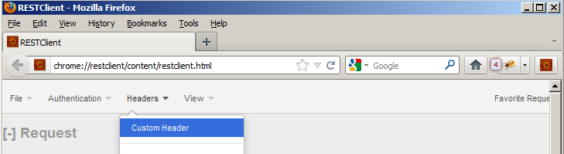
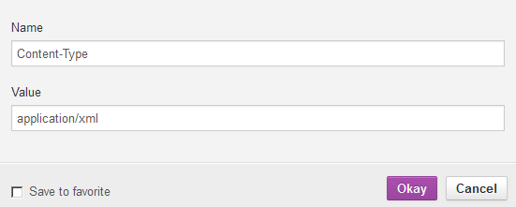
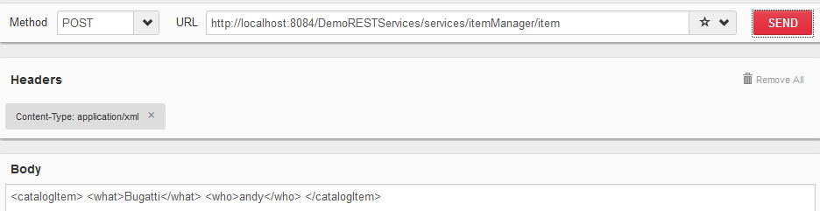
Sending Data as XML
Here's an example of how to post an item as XML
First we set the Content-Type header to application/xml
Then we post a new item as XML

Slide 10
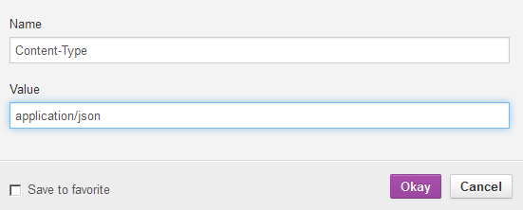
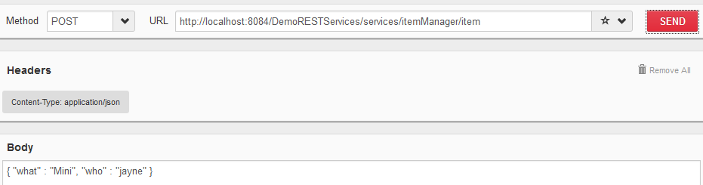
Sending Data as JSON
Here's an example of how to post an item as JSON
First we set the Content-Type header to application/json
Then we post a new item as JSON

Slide 11
3. Using HTTP PUT to Update
Implementing HTTP PUT in the service
Sending data as XML
Sending data as JSON

Slide 12
Implementing HTTP PUT in the Service
Typical role of an HTTP PUT handler method:
To update an existing item in a back-end data store
Here's how to do it:
@RequestMapping(method=RequestMethod.PUT,
value="/item",
headers={"Content-Type=application/json, application/xml",
"Accept=*/*" })
public @ResponseBody void modifyItem(@RequestBody CatalogItem item) {
System.out.println("Modifying item to " + item);
service.update(item);
}
MyFullController.java

Slide 13
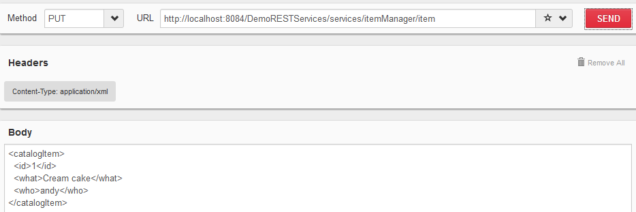
Sending Data as XML
Here's an example of how to update an item as XML
First we set the Content-Type header to application/xml
Then we update an existing item as XML

Slide 14

Sending Data as JSON
Here's an example of how to update an item as JSON
First we set the Content-Type header to application/json
Then we update an existing item as JSON

Slide 15
4. Using HTTP DELETE to Delete
Implementing HTTP DELETE in the service
Sending an HTTP DELETE request

Slide 16
Implementing HTTP DELETE in the Service
Typical role of an HTTP DELETE handler method:
To delete an existing item in a back-end data store
Here's how to do it:
Notes:
The handler method typically receives the item's unique identifier as part of the URL
Either as a path variable or as an HTTP request parameter
@RequestMapping(method=RequestMethod.DELETE,
value="/item/{id}",
headers="Accept=*/*")
public @ResponseBody void deleteItem(@PathVariable int id) {
service.delete(id);
}
MyFullController.java

Slide 17
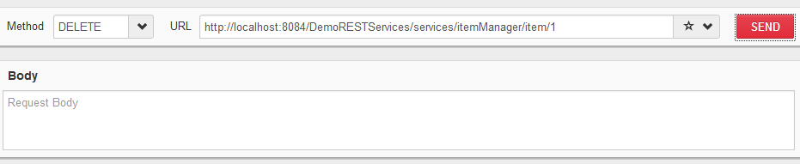
Sending an HTTP DELETE Request
Here's an example of how to delete an item
No need to set the Content-Type header!
We just send the correct URL and use HTTP DELETE

Slide 18
5. Implementing Java RESTful Clients
Overview
Using RestTemplate
RestTemplate methods
Example client

Slide 19
Overview
So far we've seen how to implement a completely functional RESTful Web service
Supports GET, POST, PUT, and DELETE HTTP verbs
We've also seen how to test the service interactively
Using the REST client plugin for FireFox
Spring also allows you to invoke RESTful services from a fully fledged client
Enables you to submit HTTP requests as XML or as objects
Also allows you to retrieve response as XML or as objects

Slide 20
Using RestTemplate
The key ingredient in Spring's support for RESTful clients is the RestTemplate class
Located in org.springframework.web.client package
Resides in org.springframework.web-3.0.3.RELEASE.jar
RestTemplate follows the conventional approach in Spring integration APIs
Simplifies sending HTTP requests to RESTful service endpoints, and retrieving the responses

Slide 21
RestTemplate Methods
Here are some of the key methods in the RestTemplate class
Method
Description
getForObject(String, Class, Object...)
Performs an HTTP GET operation
postForObject(String, Object, Class, Object...)
Performs an HTTP POST operation
put(String, Object, Object...)
Performs an HTTP PUT operation
delete(String, Object...)
Performs an HTTP DELETE operation

Slide 22
Example Client (1 of 2)
The DemoRESTClients project invokes a RESTful service
public interface MyRESTClient {
public void doRESTCalls();
}
MyRESTClient.java
@Component("MyRESTClient")
public class MyRESTClientImpl implements MyRESTClient {
@Autowired
private RestTemplate restTemplate;
private String baseAddress =
"http://localhost:8084/DemoRESTServices/services/itemManager";
@Override
public void doRESTCalls() {
// Code to call RESTful service via RestTemplate object - see next slide.
}
}
MyRESTClientImpl.java
<beans … >
…
<bean class="org.springframework.web.client.RestTemplate" />
…
</beans>
MyConfig.xml

Slide 23
Example Client (2 of 2)
Here's some sample code - discuss ☺
public void doRESTCalls() {
// GET an item (unmarshalled via JAXB).
CatalogItem item2 = restTemplate.getForObject(baseAddress + "/item/2", CatalogItem.class);
System.out.println("CatalogItem 2:\t" + item2);
// GET ALL ITEMS and display them.
System.out.println("All CatalogItems:");
CatalogItemCollection coll = restTemplate.getForObject(baseAddress + "/items",
CatalogItemCollection.class);
for (CatalogItem item : coll.getCatalogItems()) {
System.out.println("\tCatalogItem as obj:\t" + item);
}
// DELETE an item.
restTemplate.delete(baseAddress + "/item/2");
System.out.println("Deleted item 2");
}
MyRESTClientImpl.java

Slide 24
Any Questions?

